Slide 1
Strategies to get more students to read assigned materials
Nicole Nicholson, MTESL, Lecturer I, Writing & Language Studies
Claudia Vela, ABD, Instructional Developer, CTE
Javier Cavazos Vela, Ph.D., Director, CTE

Slide 2

Learning objectives
Identify strategies for getting more students to do their assigned readings
Identify the importance of the retrieval effect
Identify pre-class assignments to teach students to become active readers
Recognize in-class exercises that requires reading before class

Slide 3
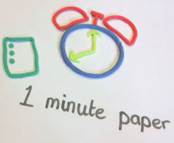
Focus activity
Take 1-minute to reflect and identify strategies that you use to motivate students to do assigned readings

Slide 4

Preparation for class activities
Doyle (2014) explained: “Students don’t do their reading and other assigned prep work because, based on their experience, they believe that teachers will discuss any important information included in the readings during class” (p. 67).
“It might be important to structure a class so that students are accountable for their pre-class activities and cannot do well without reading”

Slide 5

Retrieval Practice
Retrieval practice refers to finding information from our memory that has been learned and stored (Harringon & Zakrajsek, 2017)
Lang (2016) noted “…the retrieval effect means that if you want to retrieve knowledge from your memory, you have to practice retrieving knowledge from your memory. The more times that you practice remembering something, the more capable you become of remembering that thing in the future” (p. 20).

Slide 6
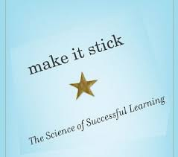
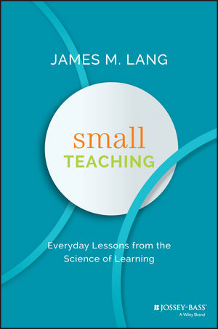
Strategies to get students to read
Quiz (retrieval practice, interleaving)
One-minute paper at beginning of class
Reading responses and guides
3-5 minute summary at beginning of class
Research on retrieval practice
Mini-lesson on reading strategies
Mini-lesson prior to assigned reading
Purposeful reading assignments/Reflections
Readiness assessment test
Asking for reading notes or summary map
Allow for student choice

Slide 7
Getting students to do the reading
According to students surveyed in higher education, taking quizzes was the most effective technique at getting them to read (Hattenberg & Steffy, 2013)
Short writing assignments was number two on this list.
Anything optional, including being called on in class or letting them work on their own was rated lower

Slide 8
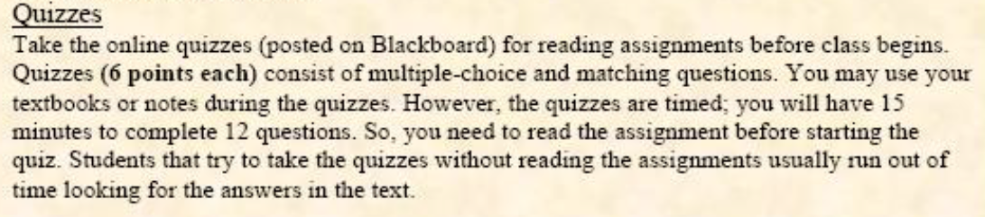
Hold students accountable for assigned readings
If we don’t grade students on an assignment, they think we regard it as unimportant.
Consider assigning 15-30% of the final grade for reading-related activities (e.g., quizzes, reading responses) and inform students about the importance of the retrieval effect:
Articulate your expectations

Slide 9
Setting expectations for good reading
Students don’t always come to our classes with great reading habits. How did you learn to read actively? In college? In grad school?
Consider direct instruction of the kinds of reading you’d like to see your students do:
  Text-based strategies
  Strategies that move “off the page,” supporting individual meaning-making and critical thinking
  Rhetorical reading strategies

Slide 10
Text-based Strategies
Pre-viewing the selection. This helps “warm up” the brain to get ready to read and look for information.
Vocabulary clarification. Should they be looking up every word they don’t know? What should they do before they look it up?
Passage clarification. What should they do if there is a whole chunk of text they don’t understand?
Visualization. This helps students think about the idea in a new way. It also helps with memory/recall.
Summary. This doesn’t have to be a paragraph. It can be an outline or a map!
If you see reading strategy workshops advertised on campus, consider encouraging your students to attend!

Slide 11
Moving “off the page”: Personal connections
Good readers automatically connect what they are reading to their own experiences and lives.
These kinds of personal connections help us to better understand and remember what we are reading.
Possible personal connections sentence starters:
  This reminds me of when …
  Something similar happened to me when …
  This sounds like something I’ve read/watched/observed before …
Click here for an example.

Slide 12
Moving “Off the page”: Questioning
Journalistic who/what/when/where/why questions are great for remembering information they will be responsible for on an exam or quiz. It can also serve as a study guide.
Genuine “I wonder” kinds of questions are great for getting students to think critically. Students can be encouraged to find questions for which the answer is not right there in the text; these kinds of questions can be fruitful seeds for reflective writing, class discussions, and even research questions. Click here for an example.

Slide 13
What else?
Take one minute to brainstorm: Are there discipline-specific reading/annotation strategies that would be beneficial for your students? What kinds of things do you mark up or look for when you are reading in your discipline?

Slide 14
Above all, Students should have a clear purpose when they read
Effective, active readers always have a clear purpose when they read.
As instructors, we know why we are assigning particular articles, but that reason isn’t always clear to our students. That can affect motivation to read the assignment.
As part of our transparent teaching practices, we can let students know what we hope they will be getting from the assigned reading. We can give them both
  Short-term applications of the reading (tomorrow’s class discussion, a quiz, etc.)
  Long-term applications of the reading (assigned essay, research project, etc.). These are usually attached to our global class objectives.
Consider a reading with purpose guide and/or preview video.
Follow up on that reading purpose in the next class (discussion, 1-minute paper, quiz, etc.)

Slide 15
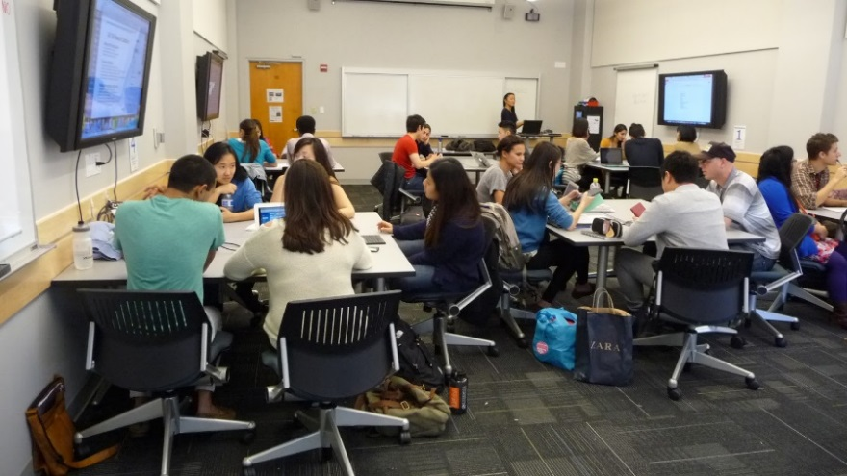
Implement Effective in class exercises that call for reading
Active learning refers to teaching strategies that “involve students in doing things and thinking about the things that they are doing” (Bonwell & Eison, 1991, p. 2).

Slide 16

First 5-minutes of class
Open-ended quiz (retrieval practice, interleaving)
One-minute paper for students to reflect on questions on assigned readings
Mini-presentation
News report
Focus with a quote, question, story, problem, or video
Make it meaningful team
Check for reading notes or summary maps
Write/pair/share from a discussion prompt (connection to reading purpose)

Slide 17


During class
Reading Groups/Circles- 5 or 6 students, each with a different role in the group:
  Discussion leader- prepared questions to facilitate discussion
Passage master – important passages that provide key information.
Creative connector- makes connections between readings
and social, cultural, political, economic ideas.
Devil’s advocate- list of questions raised by critics of the authors
Reporter- summarizer's groups discussions.
Students should know the success of this activity depends on two things:
  everyone coming prepared by having read the assignment (multiple texts)
  everyone participating

Slide 18
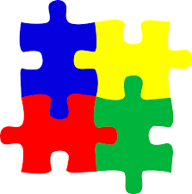
During class, cont.
Jigsaw readings
Assign different sections of the same reading to different small groups. Small groups identify the 3-5 main points from the section that their classmates need to know, plus examples.
Assign different readings on the same topic, or allow students to choose from two or three. Students who read the same article identify the 3-5 main points plus examples, etc.
Either way, students get ‘regrouped’ with other students who did not read the same section or article. Students teach each other the material.
Critical thinking extra step: Ask students to find connections between the ideas in the different sections or articles. This is a good time to practice the source integration and citation style you’d like to see in your students’ papers.

Slide 19
Final 5-minutes
One-minute paper for students to predict what will be covered in next readings (Lang, 2016)
Interleaving quiz
Focus with a quote, question, story, problem, or video
One-minute paper (What did you find most meaningful today? What did you learn? What is the muddiest point?)
5-minute application exercise (students must identify five ways in which the material they learned can be applied in outside contexts)
5-minute metacognitive five (How are you learning? What can you do to improve your learning?)

Slide 20
Reading activity: Haas & flower article
Step 1: Read
  Purpose: As you read your page of the article, identify details or examples that resonate with you as an instructor or former student. Try using some of the active reading strategies we talked about today (personal connections, genuine “I wonder” questions, visualizations)
Step 2: Share your ideas with your neighbors.
  What connections do you see between your ideas?

Slide 21

Focus activity
Take 1-minute to write which of the aforementioned strategies you would consider using in your course.
After you are done, turn to a partner and take 3-minutes to explain why you selected this strategy.

Slide 22
Just-in-Time Teaching (JITT)
JITT- “Instructors use the information gathered from quiz performance to help students prepare for exams”. Research (Weinstein & Wu, 2009; Lang, 2016) shows that frequent quizzing, compared to a few long tests, increases the chances that students will do the readings and is preferred to fewer tests by students who have experienced it.
Increased number of students who do the readings
Student perceptions of improvement in critical thinking ability
Enhanced exam scores
JITT

Slide 23
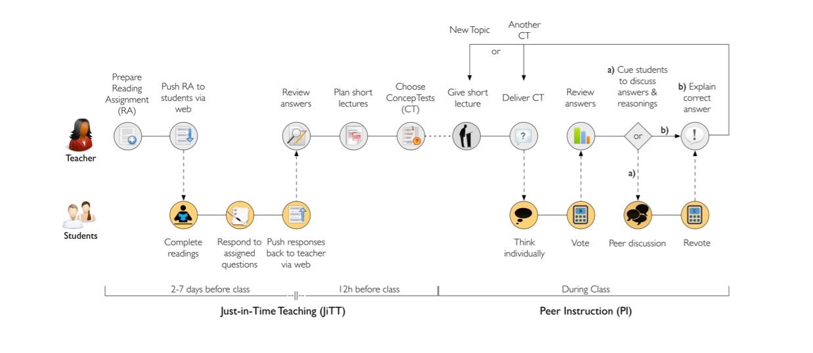
Example of JITT
https://serc.carleton.edu/introgeo/justintime/index.html

Slide 24

Why use active learning strategies?
Most learners pay attention for 15-25 minutes
Students take responsibility for their learning
Students create a sense of community and collaboration in the classroom
Students engage in discussion
Students receive formative and ongoing feedback from their peers and instructor
Students engage in higher order thinking such as application, creation, and integration based on knowledge gained from lectures and assigned readings

Slide 25
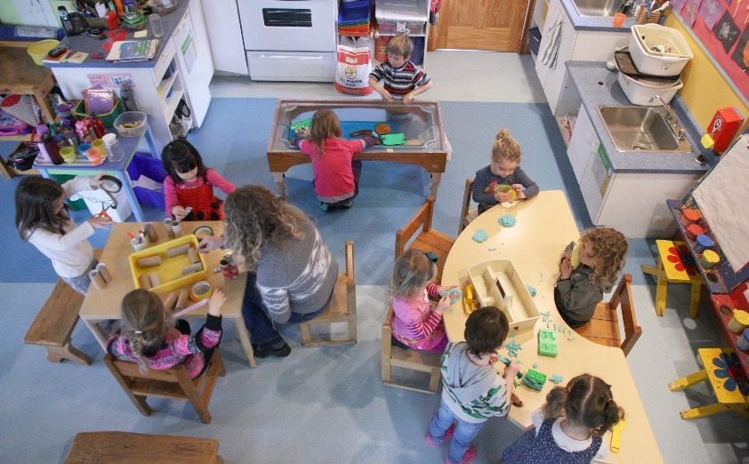
Active Learning: Research-Based Teaching Strategy
Freeman and colleagues (2014) conducted a meta-analysis of 225 studies in undergraduate STEM courses that used lecturing or active learning.
Students in active learning classes had average examination scores that were 6% higher than students in lecture-only classes while students in lecture classes were 1.5 times more likely to fail.

Slide 26

In-class activities: Active Learning and Dynamic Lecturing
Zakrajsek (2017) reported that some researchers and professors believe active lecturing is more effective than lecturing. However, Harrington and Zakrajsek (2017) support a research-based teaching strategy, dynamic lecturing, which combines lecturing with active learning strategies.
Harrington and Zakrajset cite compelling evidence that the “best approach to teaching is a blended one that incorporates lecture and active learning opportunities” (p. 15).

Slide 27

Final focus question
What did you learn today?
How can you apply what you learned to your teaching?

Slide 28
Summary map or outline
Back to slide 10

Slide 29
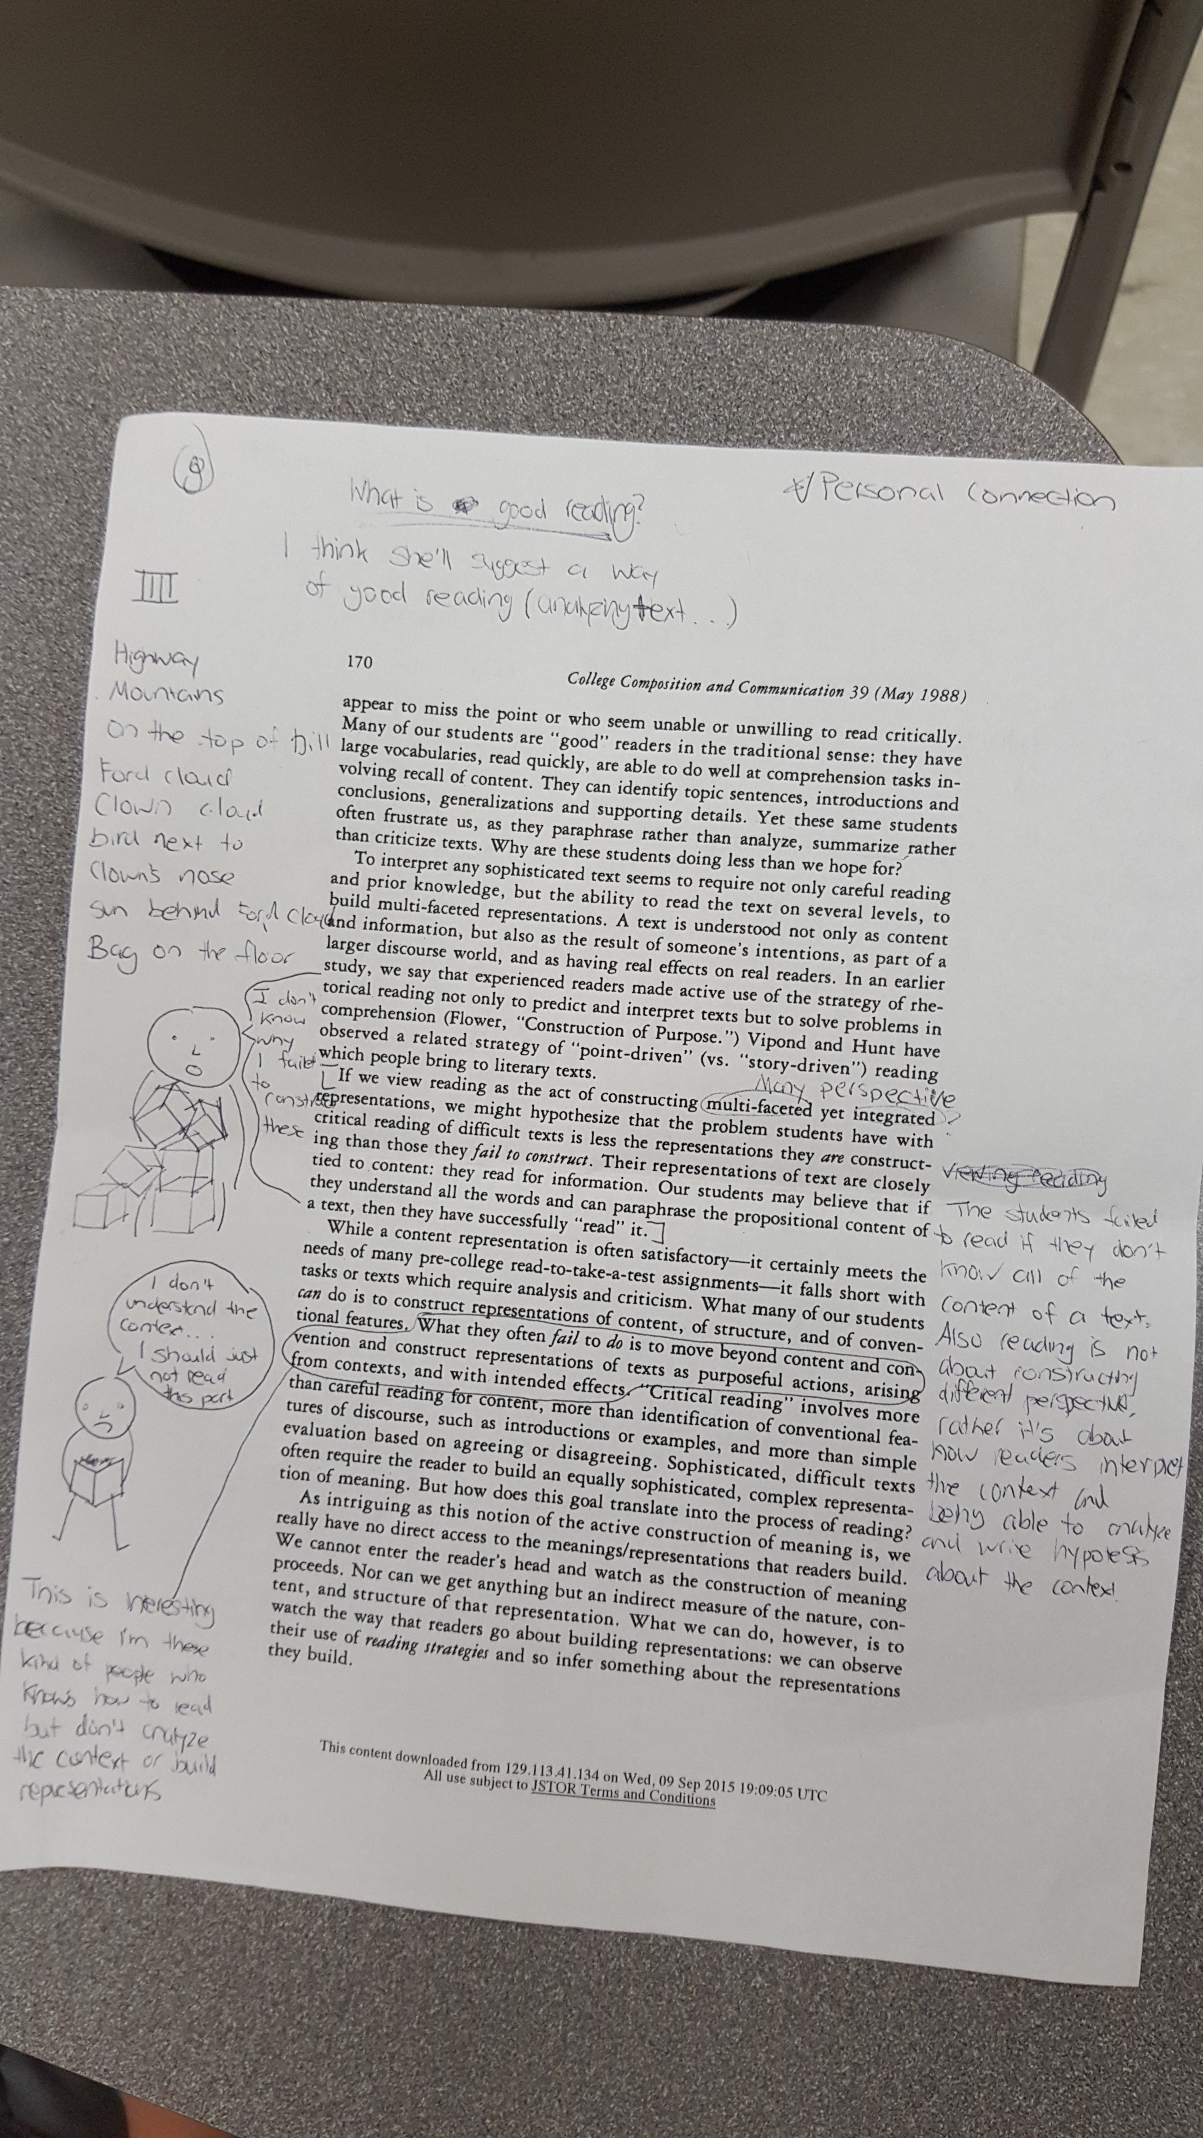
Reading notes
Back to slide 16

Slide 30
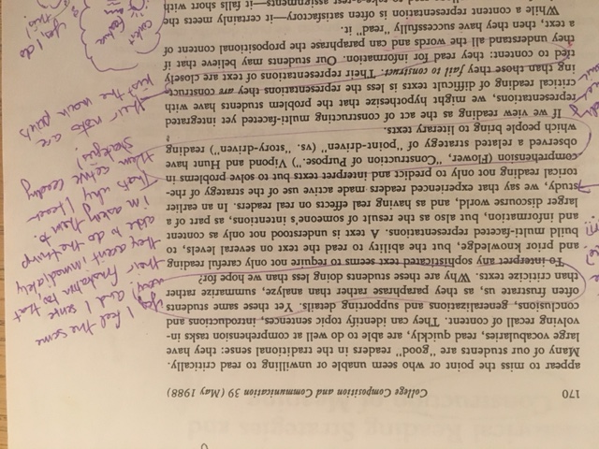
Personal connection example
Back to slide 11

Slide 31
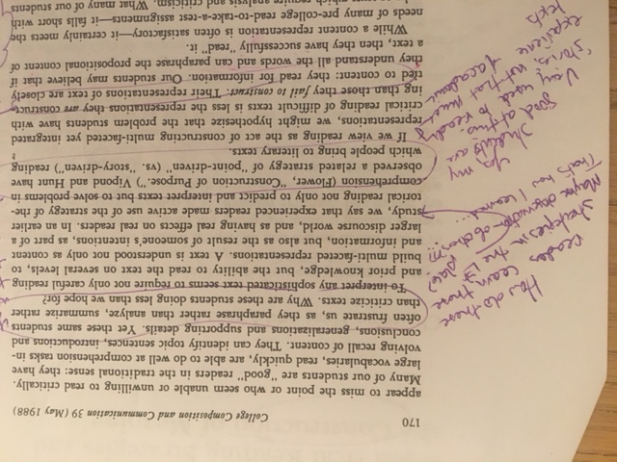
“I wonder” questioning example
Back to slide 12

Slide 32
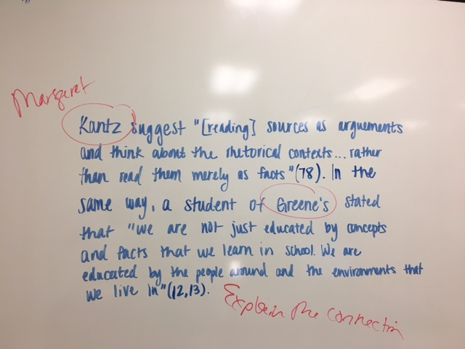
Making connections between articles Jigsaw activity
Back to slide 18

Slide 33
Reading Guide/ preview
Back to slide 14
Reading With Purpose Questions:
Vocabulary Pre-View:
Discourse
Genre
Rhetorical situation
Conventions
Reading With Purpose Questions:
What are the six traits Swales uses to define a discourse community?
Which discourse communities do you belong to? What kinds of goals, intercommunication methods, and rules of engagement are there in those communities?
The full reading guide can be found here, and a link to the preview video can be found here.

Slide 34
References and helpful resources
Bonwell, C. C., & Eison, J. A. (1991). Active learning: Creating excitement in the classroom. Washington, DC: School of Education and Human Development, George Washington University.
Gee, J. (2014). Reading circles get students to do the reading. Retrieved from https://www.facultyfocus.com/articles/effective-teaching-strategies/reading-circles-get-students-reading/
Harrington, C., & Zakrajsek, T. (2017). Dynamic lecturing: Research-based strategies to enhance lecture effectiveness. Sterling, VA: Stylus Publishing.
Hattenberg, S. J., and Steffy, K. (2013). Increasing reading compliance of undergraduates: An evaluation of compliance methods. Teaching Sociology, 41 (4), 346–352.
Lang, J. (2016). Small teaching: Everyday lessons from the science of learning. Jossey Bass.
Honeycutt, B. (2016). FLIP the first 5 minutes of class! 50 focusing activities to engage your students and create more time for learning. Raleigh, NC: FLIP It Consulting.

